Slide 1

Community Structure and Dynamics in the Dublin Meetup Network 2018

Slide 2
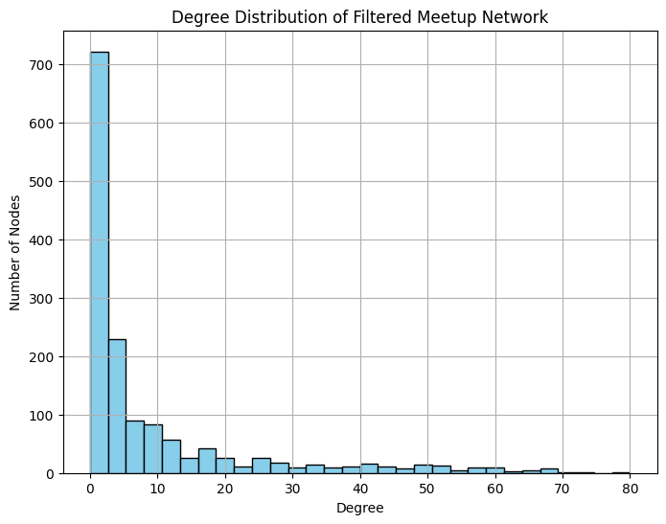
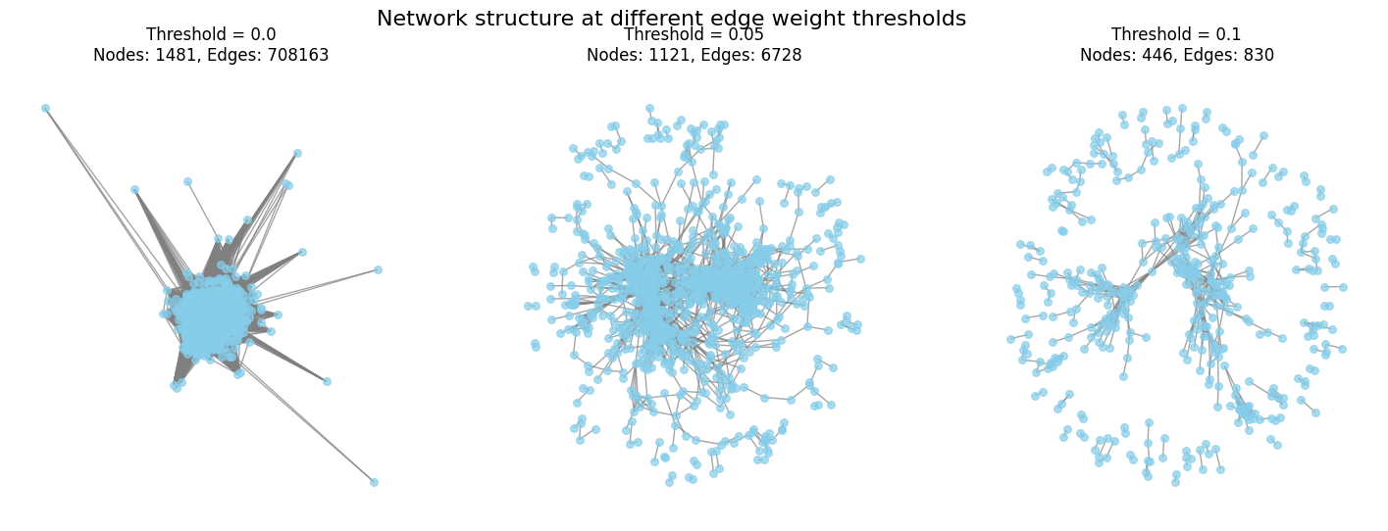
NETWORK CHARACTERIZATION AND THRESHOLDING
1481 nodes
6756 edges
Density = 0.0062

Slide 3
Do meaningful communities emerge in such a sparse network? - Louvain algorithm - 21 communities (>5 nodes) were detected. - Modularity score: Q = 0.6789 - SEMANTIC ANALYSIS USING TF-IDF technique

Slide 4
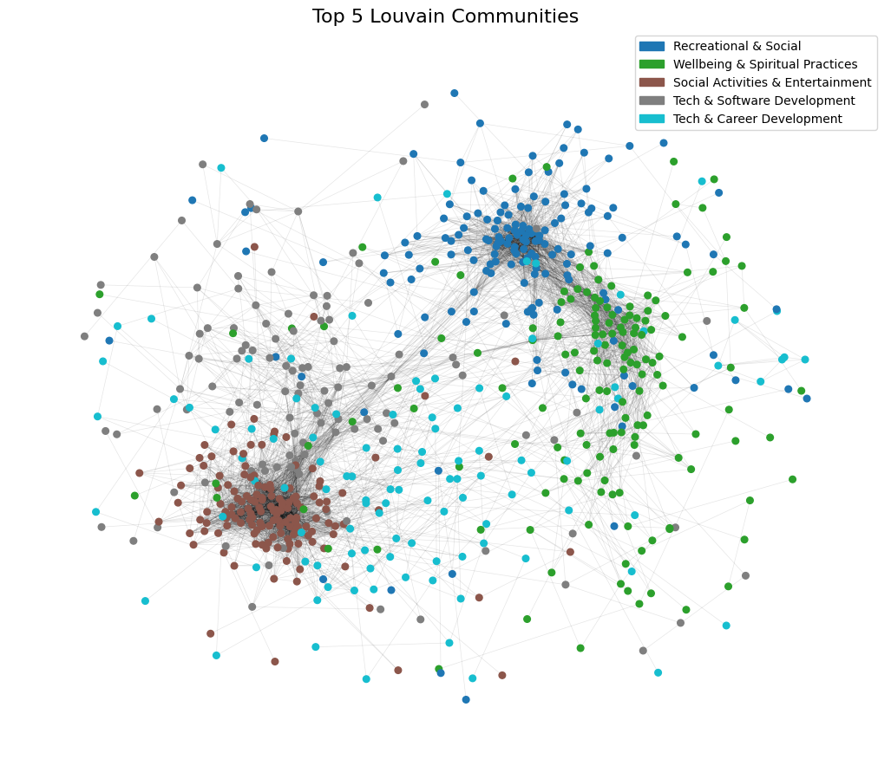
Community 0, 1, 32 - had the highest internal density (0.2016) and the lowest external connectivity (0.17)
Community 2 and 25 had the lowest density (0.0387) and the highest external connectivity (0.42)

Slide 5
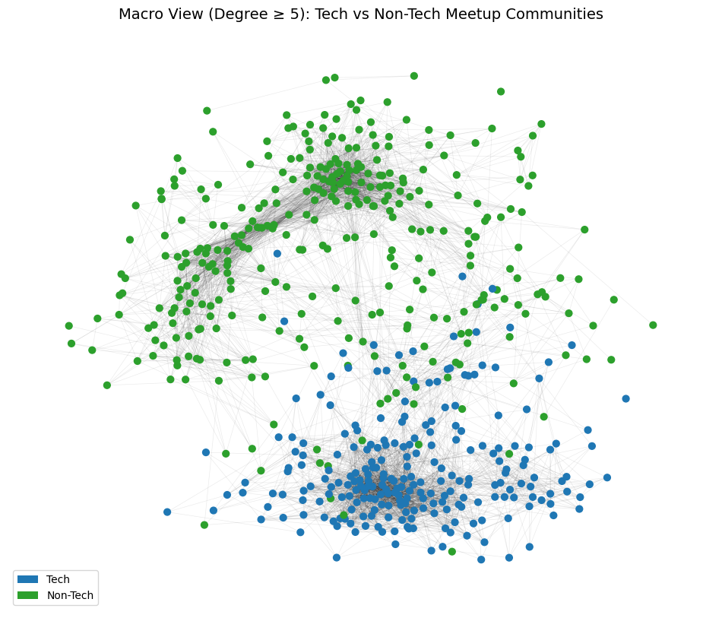
Is there a systematic distinction between Tech and Non-Tech communities?
Tech network:
- More active and interconnected
Higher density (0.0962), more high-degree nodes, more hubs, higher betweenness centrality
Non-Tech network:
- More closed and connected
- Lower density (0.0506), more compact clusters.
- Higher clustering coefficient → tighter communities.

Slide 6
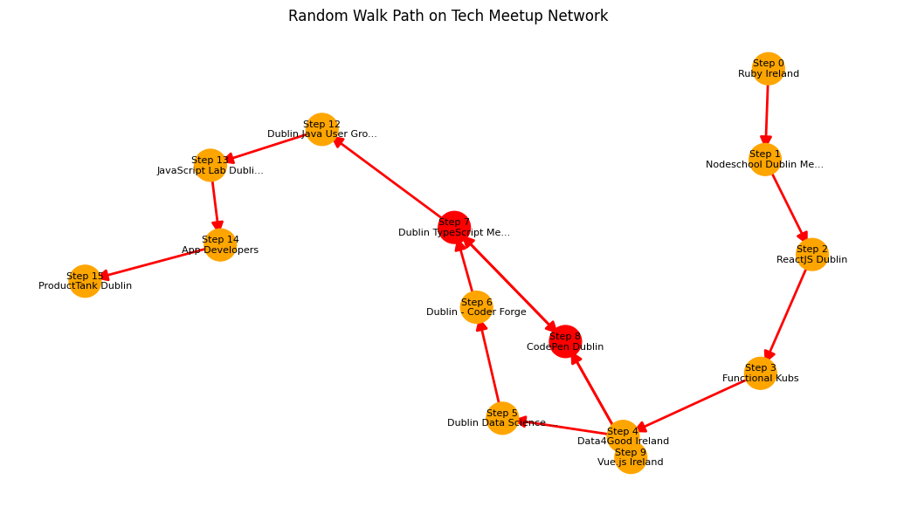
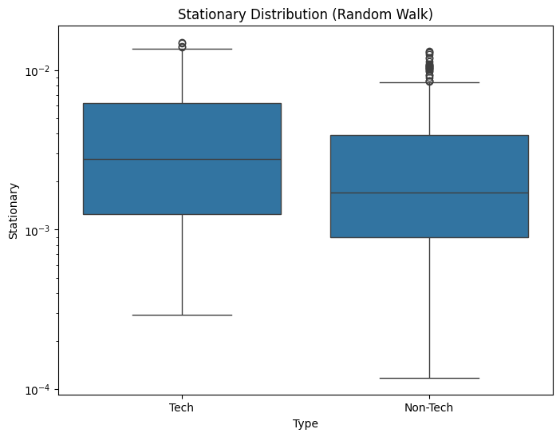
Dynamic Overview: Long-Term Visibility of Communities

